Slide 1
Accessing the Curriculum for Diverse Learners
Literacy – what is it?

Slide 2
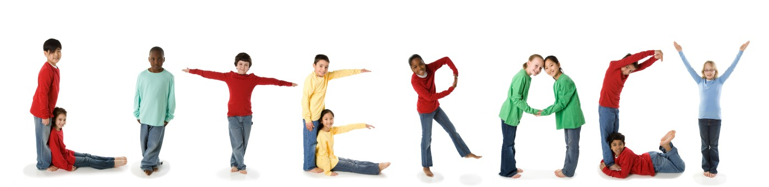
What is Literacy?

Slide 3

What is Literacy?

Slide 4
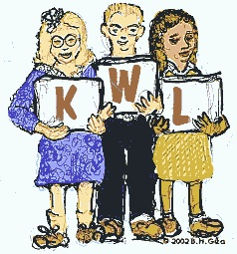
Activating prior knowledge

Slide 5

What did we believe about literacy development?
Students need to be at a certain “developmental” level before literacy instruction could be introduced
If a student didn’t have prerequisite skills s/he had to master them before being considered “ready” to really read and write
These skills to be mastered had to be taught in a hierarchy, without missing any of the steps

Slide 6
Now what do we believe about literacy development?
Learning to read and write begins early in life
Occurs years before formal educational opportunities begin
Begins to develop with early communication and interaction skills
The ability to read is acquired in much the same as spoken language – during the thousands of hours of meaningful interaction with others (often before entering school)

Slide 7
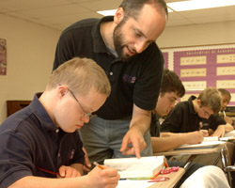
Also we know …
Many students with significant (developmental) disabilities CAN learn academic skills and knowledge that was previously not expected
Literacy and numeracy skills, as well as content knowledge, will increase students with disabilities opportunities with employment and every day living

Slide 8
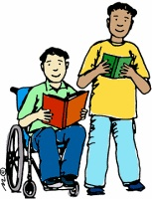
Also …
L
R
E

Slide 9
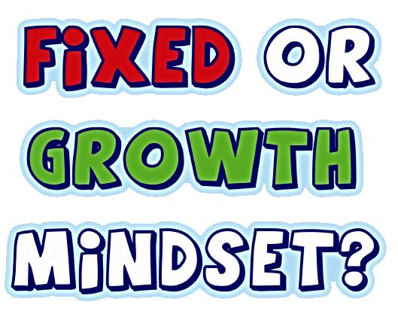
Changing Views

Slide 10

Emergent Literacy
Early home, preschool and school experiences provide important supports for the development of literacy skills
Literacy rich, print-rich environment
Interactions while reading with adults supports language and thinking
Reading to children contributes to their development of language

Slide 11

Emergent Literacy
Positive language changes occur when students are read (story)books repeatedly
Adults use complex language structure during routines such as (story)book interactions

Slide 12
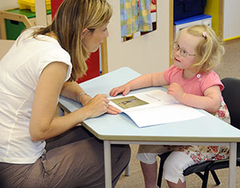
Literacy and students with significant language impairments
Research shows that:
Adults read to children with disabilities but not as often and tend not to offer repeated readings of books
Adults typically dominate the interactions
Adults often ask children to label pictures, rather than talking to them about the story (making comments, asking other types of questions)

Slide 13
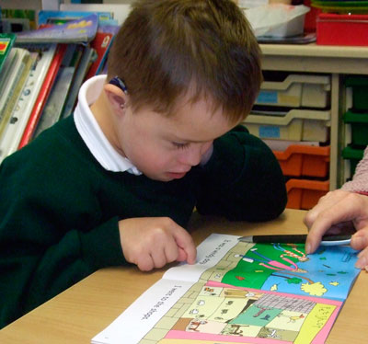
Barriers to Literacy Instruction in the School System
Attitudes
Low expectations
Limited opportunities
Limited means of access
Limited time
The age factor

Slide 14
What are the barriers in schools? (Downing, 2005)
Attitudes
The student is too disabled to acquire reading skills and cannot benefit from instruction.
Low Expectations
These students may not be expected to read or write. There may be no IEP goals in this area.
Limited Time
There is limited time that educators have to adapt and design appropriate literacy materials.

Slide 15
What are the barriers in schools? (Downing, 2005)
4. The Age Barrier
This is the belief that if children do not acquire literacy skills by a certain age, then efforts at further literacy activities should not be attempted.
Remember: students with disabilities do not always follow the typical progress on literacy skill development – therefore students may:
be considerably older before they begin to show skills
learn skills in a very unique manner depending on interests, experiences, abilities and expectations of others

Slide 16
Continuum of Literacy Instruction
Emergent Literacy
Learning about print and sound
Early Literacy
Learning to read
Conventional Literacy
Reading to learn / comprehension

Slide 17
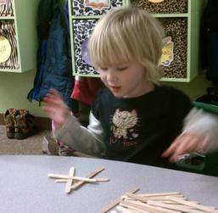
Emergent Literacy Concepts
Print Awareness
Concepts of print
Concepts of a word
Concept of a letter
Talking about print

Slide 18
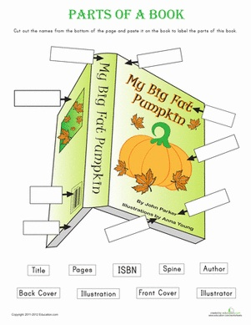
What do you know?

Slide 19
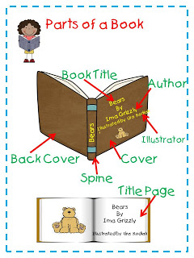
Concepts of Print
Knows that a book is for reading
Identifies front, back, bottom, top of book
Turns pages properly
Recognizes the difference between words and pictures
Knows where to begin reading a page
Knows what a title is

Slide 20
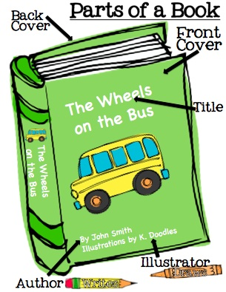
Concepts of Print
Knows what a title is
Identifies page numbers
Knows print is read from left to right
Knows that print is spoken language written down
Knows print in the environment and logos

Slide 21
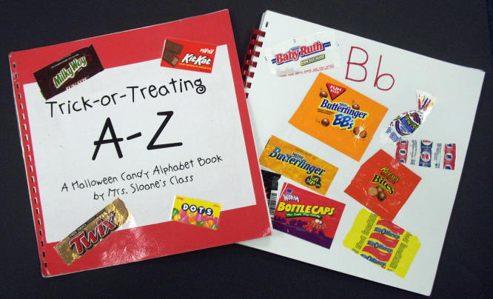
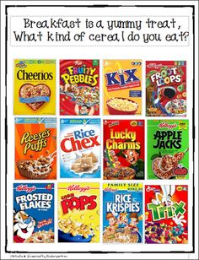
Environmental Print

Slide 22

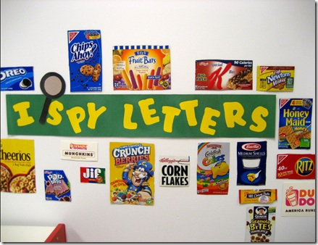
Environmental Print

Slide 23
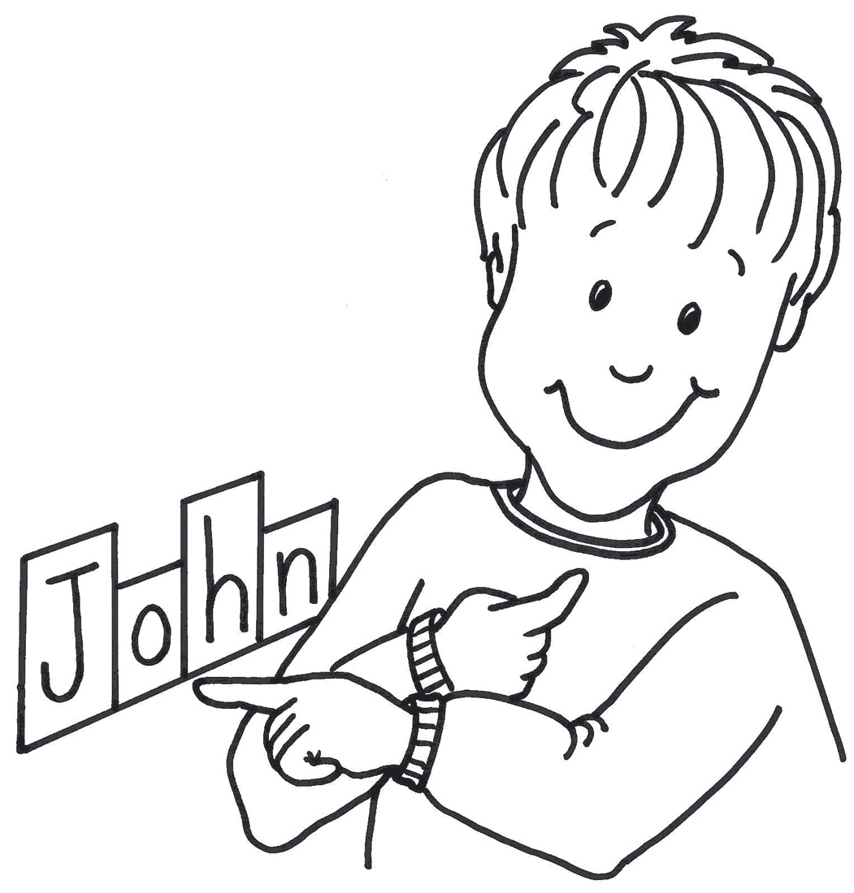
Concept of a Word
Knows what a word is
Can point to words on a page
Finger point readings of memorized texts
Demonstrates 1:1 correspondence
Reads own name
Recognizes names in various formats

Slide 24
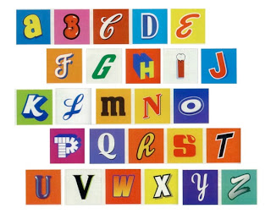
Concept of a Letter
Discriminates letters from symbols and from each other
Writes letter-like and letter forms
Begins to name letters
Sings / says alphabet

Slide 25
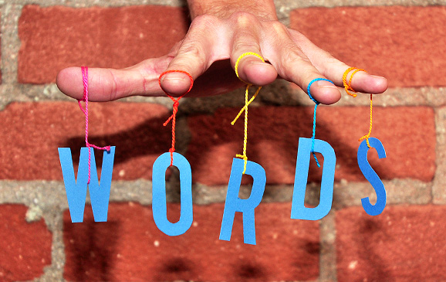
Concept of Letter and Words
Concept of letter is not the same as knowing the alphabet
Can say the “marks” in a book are called letters
Understands that letters are used to represent words and that words are units of meaning
Bedrock to early understandings

Slide 26

Why Provide the Opportunity to Learn Reading?
Students “potential” to make progress is unknown without the opportunity to learn
Students who are not disabled are not required to “master” all skills before getting to learn to read
Academic instruction for students who are nondisabled does not end at the first sign of “no progress”
Reading is a pivotal skill that can enhance adult outcomes

Slide 27
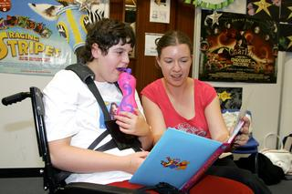
Why Provide the Opportunity to Learn Reading?
Even if students do not become literate, the acquisition of emergent literacy skills can open opportunities to enjoy and benefit from a wide range of activities with peers
Best practices in reading instruction benefits all students
Students with significant disabilities have shown they can learn beyond sight words

Slide 28
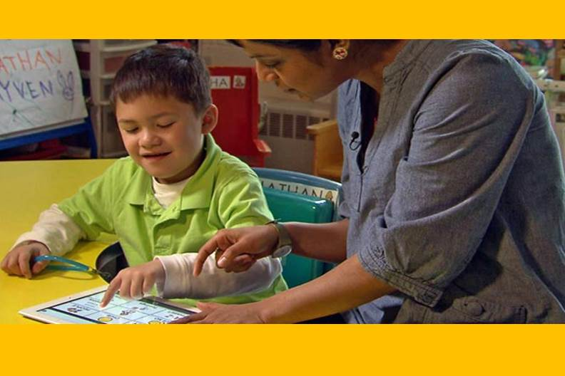
Why Provide the Opportunity to Learn Reading?
Provides students with access to regular curricular and peer activities
Literacy is a functional skill

Slide 29
Activating prior knowledge

Slide 30

Pair-share
What significant piece of learning engaged you?
What is the relevancy of it to your role as an EA?
Share with a classmate

